Slide 1

The Battle of Neighborhood - Hyderabad vs Bangalore
Ibm Professional data science certification capstone project.

Slide 2

Contents
Introduction
Data used
Methodology
Results
Discussion
Conclusion

Slide 3
Introduction – problem statement
As the people doesn't know where to live or start to work in a country, I am representing in this report how to start and which colony is having all the resources such as utilities, groceries, gym, IT services etc. And one more thing:
1. Which is the good place to start?
2. Where we can we get all the resources as I mentioned above?
3. In the given neighborhood, is there any good rating services like online-ordering food is avaiable?
I will try to answer the following questions:
1. Where is the good place to start in hyderabad or bangalore?
2. Where are the 'amenities' located?
3. Recent activities and Most common venues
4. Suggests the best place to start either in hyderabad or in bangalore.

Slide 4
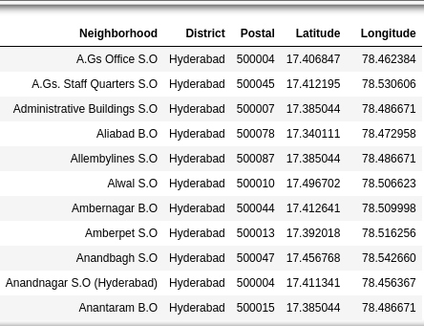
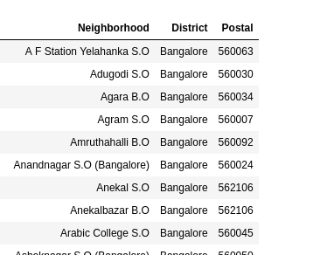
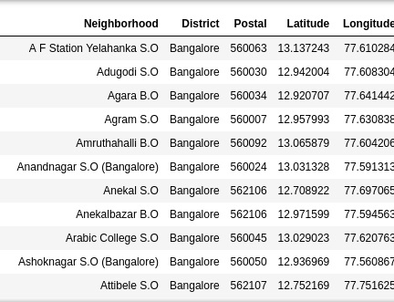
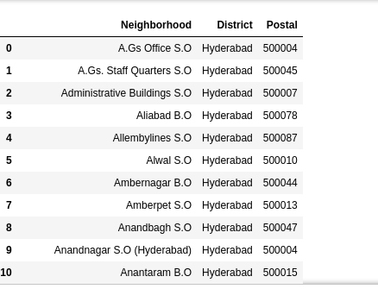
Data used
Hyderabad district pincode from the site (https://finkode.com/ap/hyderabad.html).
Bangalore district pincode from the site (https://finkode.com/ka/bangalore.html).
After using the geocoding API, we will create latitudes and longitudes for the given addresses.

Slide 5
methodology
First, we scrape the data using beautifulsoup.
Second, we find the latitudes and longitudes of the given addresses(using Gmaps geocoding API)
Third, we will plot those coordinates using the folium map.
Fourth, We will find the number of collisions in the given dataset.
Fifth, Using the dataset, we will use FourSquare API for finding the places resided near to those pin codes and merge with the original dataset
Sixth, To use this dataset for predicting the most common venue, we have to use one-hot encoding for K-means Clustering algorithm.
Seventh, Using the silhouette score, we will find the best K-value for our most common venue prediction.
At last, Using the K-value, we will find the cluster labels for each an every place and last we will plot the map and find the most common venue point in the selective district.

Slide 6
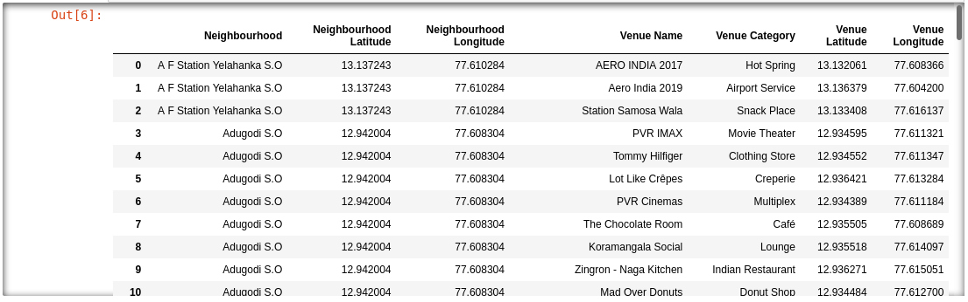
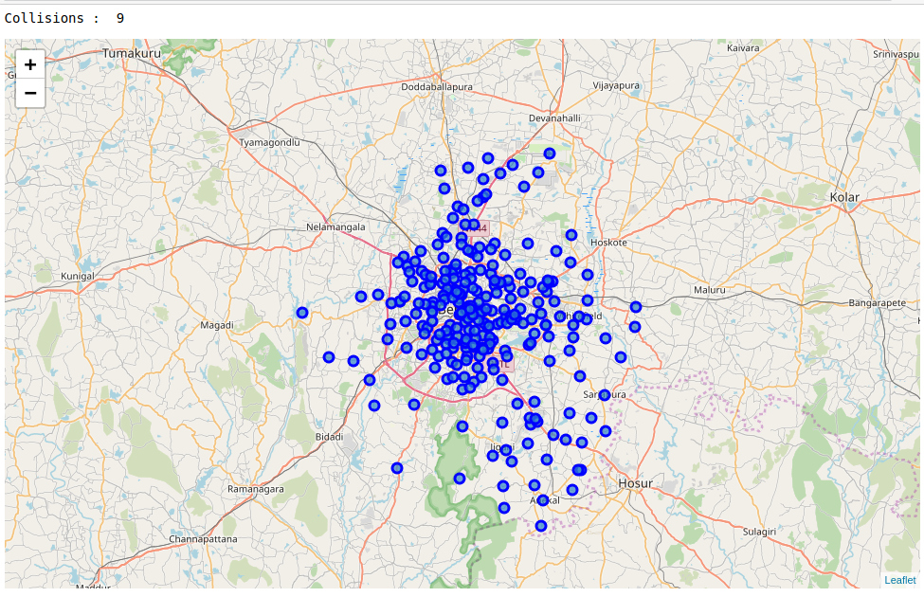
Methodology- Bangalore dataset

Slide 7
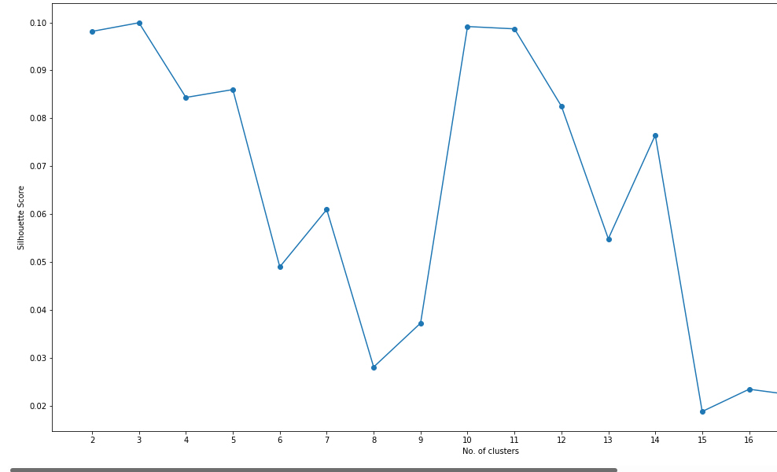
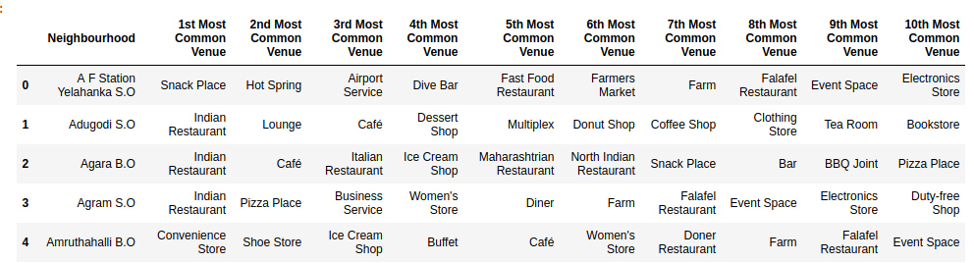
Methodology-Bangalore dataset cont'd
Silhouette score and Most common venue.

Slide 8
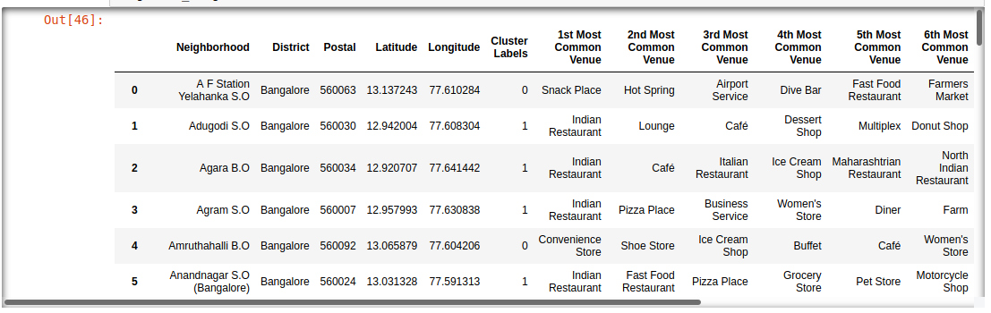
Methodology- bangalore dataset cont'd final cluster labels

Slide 9
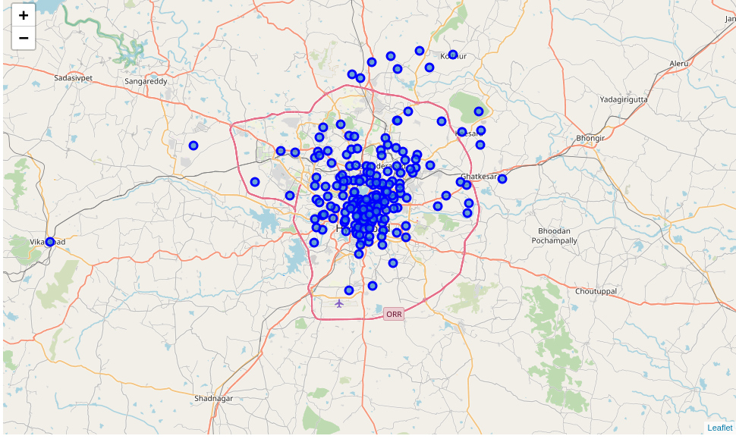
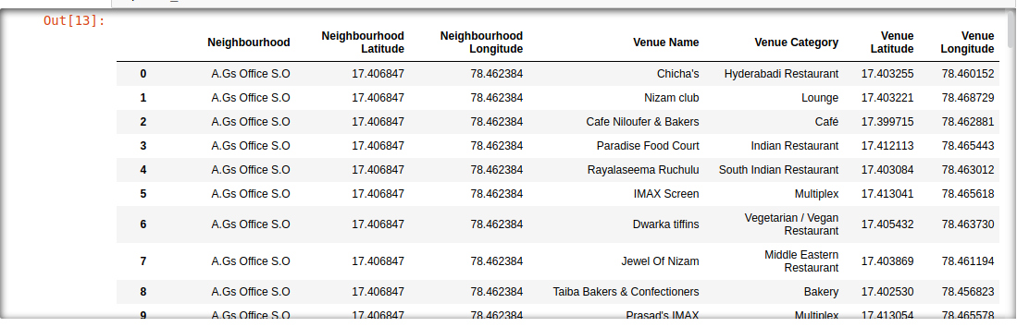
Methodology- Hyderabad dataset
Places with lat and long and plot of the places(pin codes).

Slide 10
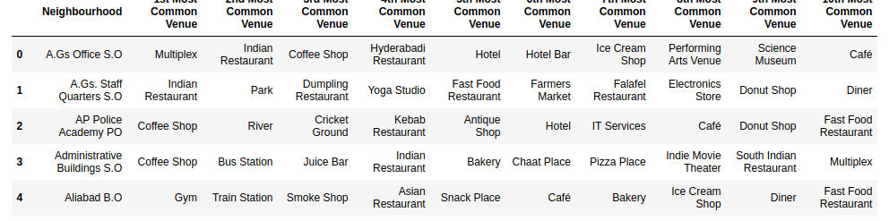
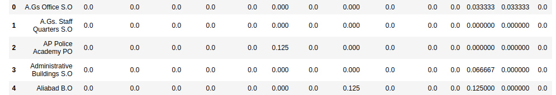
Methodology- Hyderabad dataset cont'd
One-hot encoding and Most common venue.

Slide 11
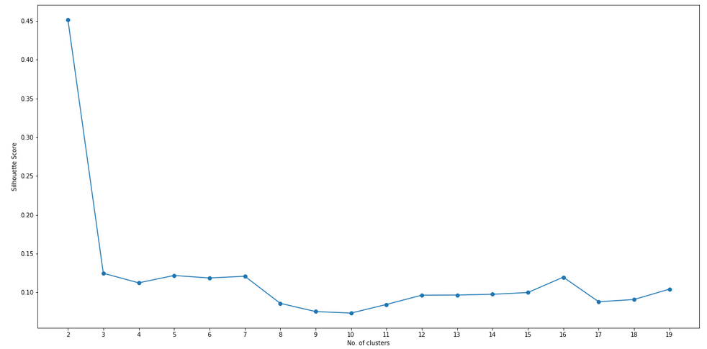
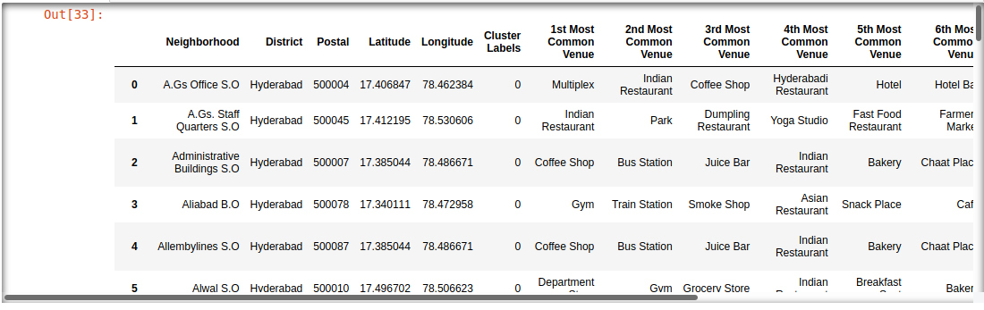
Methodology Hyderabad – Cont'd Silhouette score and final cluster labels

Slide 12
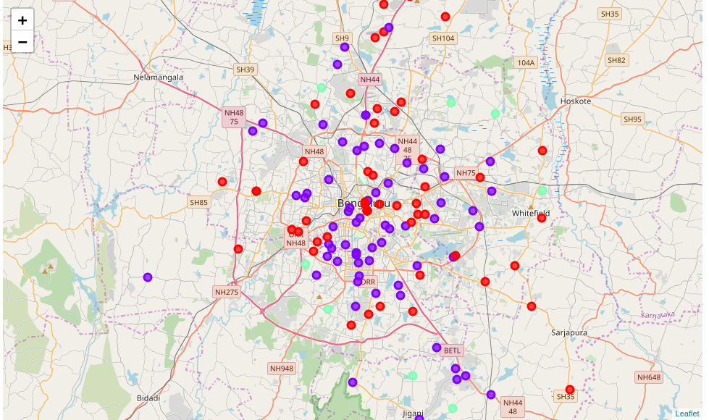
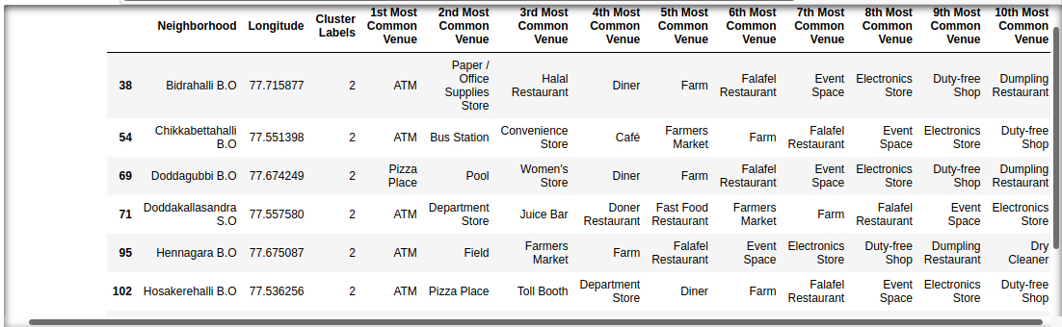
Results for Bangalore dataset

Slide 13
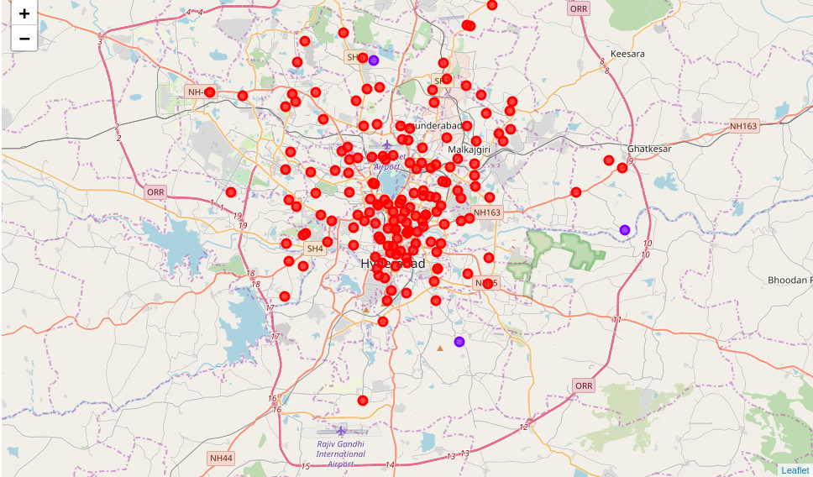
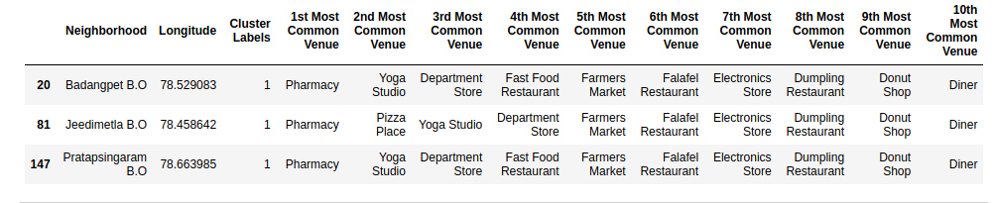
Result for Hyderabad dataset

Slide 14
Discussion
According to the above analysis, the best place to start to live in Bangalore are Bidrahalli, Chikkabettahalli, Doddagubi, Doddakallasandra, Hennagara, Hosakerahalli, Hulimangala and Kadugodi.
And the best place to start to live in Hyderabad are Badangpet, Jeedimetla and Pratapsingaram.
In those above places all of the required essentials are available in the given neighborhood.

Slide 15
Conclusion
We got a glimpse on where to start to live in these cities which I have taken as my project I.e Hyderabad and Bangalore.
In Hyderabad, the best place to start is ,having three places whereas, in Bangalore there are eight places to start with.
All of the mentioned places are having all the amenities and IT sectors are booming in both of these districts.
I conclude that no matter, where we start, start from a place where it is comfortable for you in terms of language, society etc which is of course, out of presentation topic.
The above mentioned places are best places to start whether it is Bangalore or Hyderabad.

Slide 16
Thank you!
By -
SIDDHARTH DATTHATHREYA
Siddharthdathathreya@gmail.com
9110722698

